Slide 1
A SURVEY ON SLUM AREA

Slide 2
Slum dwellers in india-fulfilling daily need is a challenge
Slum area dwellers in india are regularly suffering with lack of cleaning water.
There is a unsanitary living conditions.
There is a high level of pollution.
There is lack of basic needs like cleaning,education,houses etc,.
The india is the Third-Largest country that which suffers from poverty.
Because of this lack of basic needs there is hundreds of thousands of mens,womens,childrens that means 25% of people causing death.

Slide 3
Who are slum dwellers?
The slum Dwellers manifest that transcends income poverty.
They are insanitary , unhealthy by their living conditions.
They are suffering from lack of safe drinking water, sanitation, storm drainage, streetlighting, education, health care etc…
Many of these habitations are located in environmentally fragile and dangerous prone to landslides , floods and other disasters that make the poor residents highly
.
Civic bodiesdo not provide the required municipal services in the slums on the plea that these are located on ‘illegal’ space.

Slide 4
Problems faced by the slum dwellers in india
The problems faced by the people living as the slum dwellers in india have become significant concerns for the government.
Slums are considered the major issue within many urban areas; particularly transportation, population, health, and safety.
The Government of India has not been able to solve the problems that are strangling the entire population of Indian slums.
Most families affected by urban development projects are located in slum areas under consideration for resettlement or rehabilitation.
There is a need to examine slum areas and their living conditions and determine the most critical and problematic zone of the slums.

Slide 5
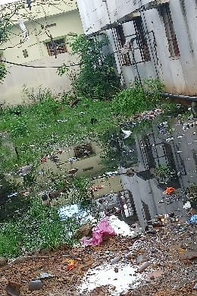
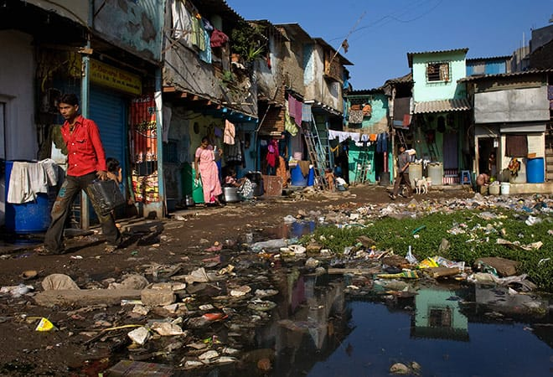
Lack of basic necessities

Slide 6
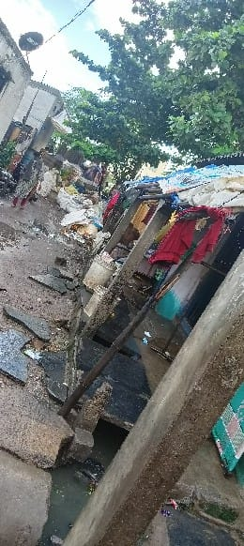
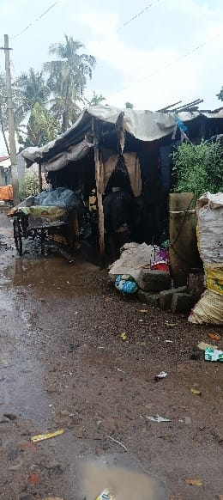
Overcrowding and high density
Overcrowding has been associated with a low space per person living in an area, high occupancy rates, cohabitation by different families and a high number of single-room units.
Mostly slum-dwelling units are overcrowded, with five to six and more persons sharing a one-room unit used for cooking, sleeping and living.
Substandard Housing or Illegal and Inadequate Building Structures.

Slide 7
Insecure tenure ,irregular or informal settlements
Informal or unplanned settlements are often regarded as synonymous with slums.
Mostly emphasise both informality of occupation and the non-compliance of settlements with land-use plans.

Slide 8
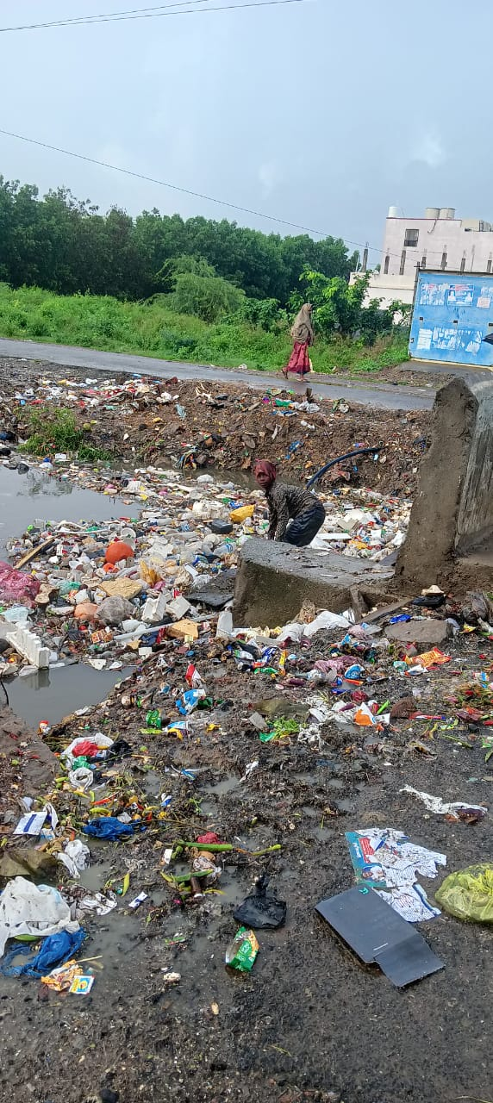
Minimum settlement size
Many slums also require some minimum settlement size for an area to be considered a slum, so that the slum constitutes a distinct precinct and is not a single dwelling.
Examples are the municipal slum definition of Delhi that requires a minimum of 700 square meters to be occupied by huts, or the Indian census definition, which requires at least 300 population or 60 households living in a settlement cluster.

Slide 9
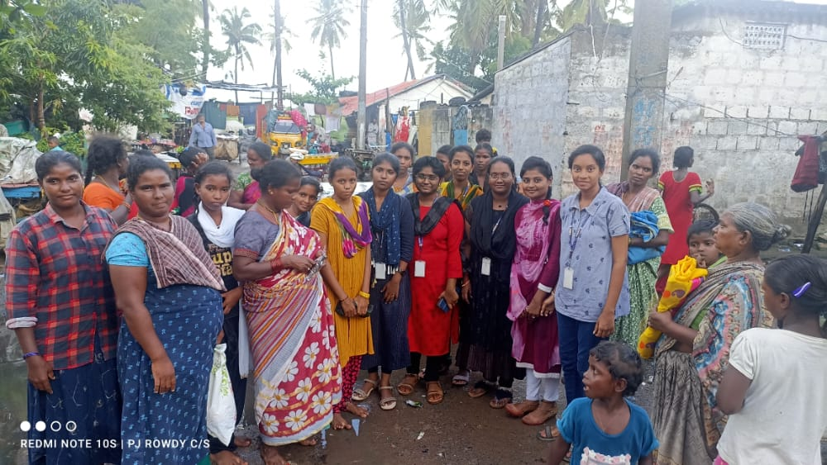
Recommendations for improving conditions of slum dwellers in india
State governments have to develop strategies to prevent the formation of new slums. These should include access to affordable land, reasonably priced materials, employment opportunities, and basic infrastructure and social services.

